Slide 1

ENGINEERING CHEMISTRY
Asha A
Department of Science and Humanities

Slide 2

ENGINEERING CHEMISTRY
Module I- Molecular Spectroscopy
Class Content:
Vibrational spectroscopy
Expression for vibrational energy levels (Harmonic oscillator)
Vibrational spectrum(Harmonic oscillator)

Slide 3
ENGINEERING CHEMISTRY
Module I- Molecular Spectroscopy
Vibrational Spectroscopy
When a molecule undergoes vibrational changes it absorbs IR radiation
For a molecule to be vibrationally active (IR active) the vibration of a molecule must be associated with change in dipole moment
Vibrations of molecules can result in changes in electric dipoles that can interact with the electrical component of the electromagnetic radiation.

Slide 4
ENGINEERING CHEMISTRY
Module I- Molecular Spectroscopy
When the frequencies match, resonance occurs and the molecule absorbs energy and goes to the higher vibrational levels and exhibits vibrational spectrum
Molecules such as HCl, CO and H₂O will show vibrational spectra while H₂, Cl₂ will not show vibrational spectra.
CO₂ molecule does not possess permanent dipole moment but is IR active as when it vibrates asymmetrically or in bending mode, there is change in dipole moment

Slide 5
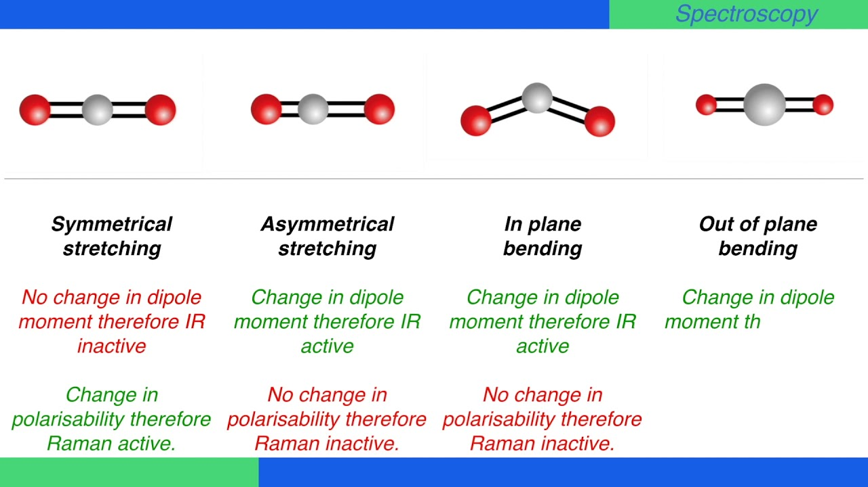
ENGINEERING CHEMISTRY
Module I- Molecular Spectroscopy
CO₂ molecule although does not possess permanent dipole moment is IR active because some of its vibrational modes are IR active:
CO₂ symmetric stretch is IR inactive as there is no change in dipole moment when molecule vibrates in this mode.
CO₂ asymmetric stretch is IR active
CO₂ bending mode is IR active
Source: http://cepekmedia.co.nf

Slide 6
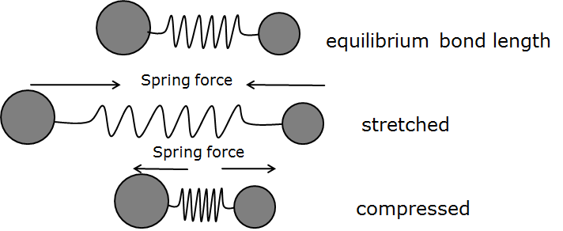
ENGINEERING CHEMISTRY
Module I- Molecular Spectroscopy
Vibrational spectroscopy of diatomic molecule: simple harmonic oscillator (SHO) model
Every type of bond in a molecule has a unique natural vibrational frequency
Therefore the IR spectrum of every molecule is unique as much as the finger print of human beings
Bonds are not static but vibrating in different ways
A vibrating bond can therefore be considered a spring with its ends tethered to two atoms as in the figure and obeys Hooke’s law
Source : Ramasahayam, Swathi & Roy Chowdhury, Shubhajit. (2016). Non Invasive Estimation of Blood Urea Concentration using Near Infrared Spectroscopy. International Journal on Smart Sensing and Intelligent Systems. 9. 10.21307/ijssis-2017-878.

Slide 7

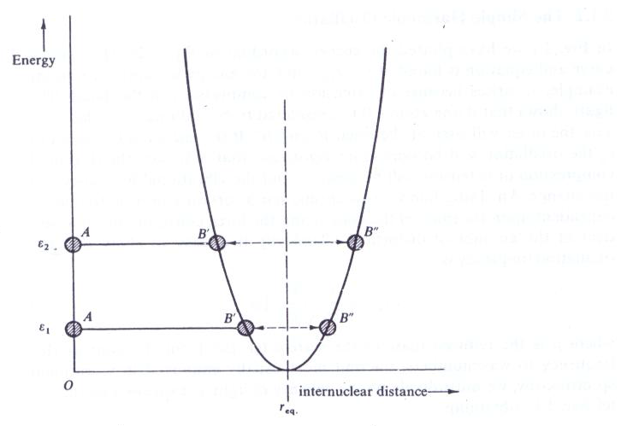
ENGINEERING CHEMISTRY
Module I- Molecular Spectroscopy
The vibrating bond obeys Hooke’s law, F=-k(r-r_{eq})
where k is a force constant, r is bond length, r_{eq} is equilibrium internuclear distance
Energy is given by
Hence the energy curve is parabolic
Source:Fundamentals of Molecular Spectroscopy: C. N. Banwell and Elaine M McCash, Fifth Edition, MCGRAW-HILL Education (India) Private Ltd.

Slide 8
ENGINEERING CHEMISTRY
Module I- Molecular Spectroscopy
The oscillation frequency is given by,
where μ is reduced mass
Expressing frequency of oscillation in terms of wavenumber
Solving Schrodinger equation for harmonic oscillator shows vibrational energy levels are quantised and are given by the expression
where v= vibrational quantum number which can take up values zero upwards; v=0,1,2,3....
Vibrational energy expressed in terms of wavenumber is given by,

Slide 9
ENGINEERING CHEMISTRY
Module I- Molecular Spectroscopy
The energy levels will appear at,
ε_{o} is called zero point energy
The difference between any two consecutive energy levels is equal to
Hence the energy levels are equally spaced.
The selection rules for vibrational transitions are
Gross selection rule : When the molecule vibrates there should be a change in the dipole moment
Δv = ± 1
Therefore transition between any two consecutive vibrational levels are allowed
and only one line is observed in the vibrational spectrum at
v | ε_{v}
0
1
2

Slide 10
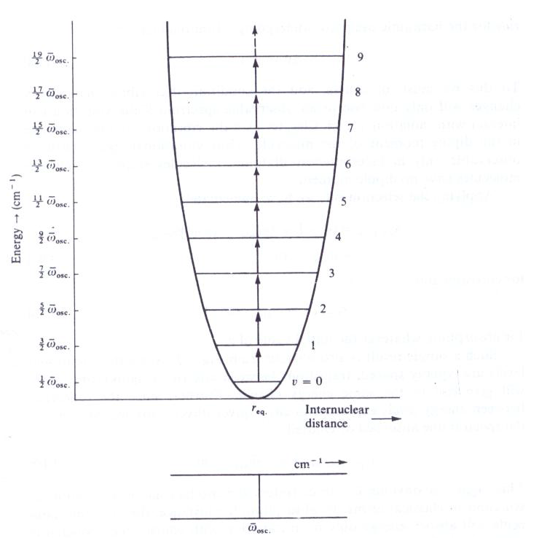
ENGINEERING CHEMISTRY
Module I- Molecular Spectroscopy
Vibrational energy levels and resulting spectrum for a diatomic molecule
executing simple harmonic motion
Source:Fundamentals of Molecular Spectroscopy: C. N. Banwell and Elaine M McCash, Fifth Edition, MCGRAW-HILL Education (India) Private Ltd.
From the spectrum can be obtained and using the expression
k can be determined which is the bond strength of the molecule

Slide 11
THANK YOU
Asha A
Department of Science and Humanities

